Slide 1
Circuits

Slide 2
By the end of this lesson you will be able to:
Describe what a circuit is.
Explain how energy is transferred around a circuit.
Demonstrate how to draw a circuit.

Slide 3
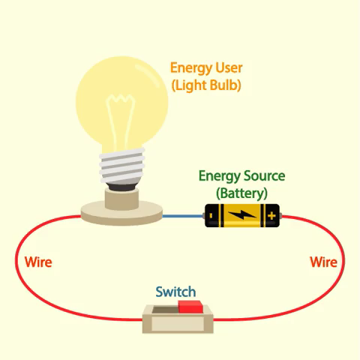
A circuit is a loop of wire which connects an energy source to an energy user.
The energy source is usually a battery. However, it could also be a generator.
The energy user is an object that needs the energy from the energy source. Some common energy users are light bulbs, heating elements and motors.

Slide 4
A torch is a great example of a simple circuit.
In a torch, the energy source is the battery and the energy user is the light bulb.
Remember: These two circuit components are joined by wires.

Slide 5
The components of every circuit are joined by wires.
We need to use wires in circuits so that electrons can flow between circuit components.
These moving electrons transfer energy from the energy source to the energy user.

Slide 6
An energy source can be a tiny battery or a huge generator!
The energy source provides the electrons with the energy they need to flow around the circuit.
The electrons are already in the wire. The energy source just pushes them around the circuit.

Slide 7
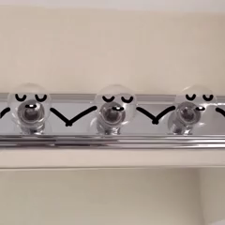
6 of 37
Processing...
The electrons transfer energy from the energy source to the energy user.
The energy user then transforms the energy into a useful form.
For example, a light bulb would transform the electrical energy of the electrons into light energy.

Slide 8
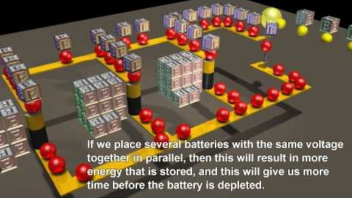
Electron flow is crucial to the transfer of power around a circuit.
Watch this video (0:34) to see how electrons flow around a circuit.

Slide 9
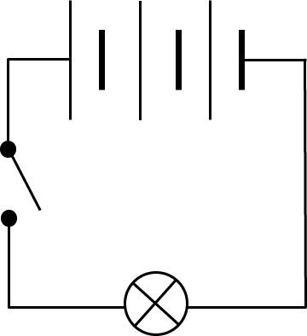
We can represent circuits and their components with circuit diagrams.
There are a few important circuit components that you need to know the symbols for.
This will allow you to draw circuit diagrams.

Slide 10
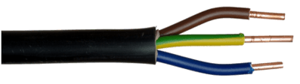
The first important circuit component is the wire.
It is represented by a straight line.
When you draw a circuit diagram, you must make sure that the circuit components are connected by a wire.

Slide 11
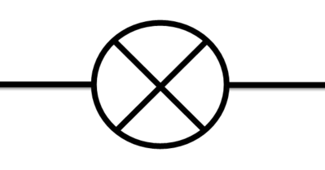
Light bulbs and LED lights are very common circuit components.
Light bulbs are represented by a circle with an X through the middle. Notice how straight lines on either side of the light bulb represent the wires connecting it to the rest of the circuit.

Slide 12
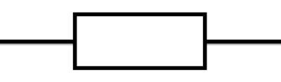

We try to keep the symbols for circuit components as simple as possible to make drawings clear.
A resistor is an object which resists the flow of electrons.
It can be represented by either a box or a zigzag line.

Slide 13
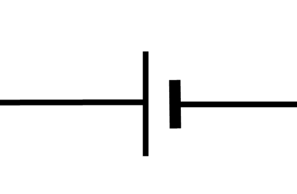

A cell is a type of energy source.
It is represented by two lines, one of which is longer than the other.
A battery is made out of several cells which are joined together.
A battery may be drawn as shown below, or it could be represented by a two cells connected by a dotted line.

Slide 14
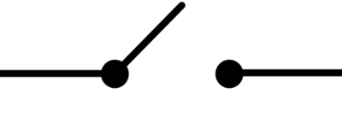
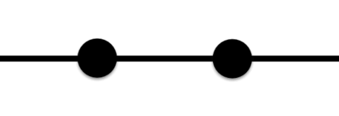
Many household circuits have switches.
When a switch is closed, it allows electrons to flow across it. Electrons are not able to flow across an open switch because the circuit is broken.

Slide 15
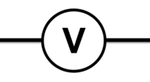
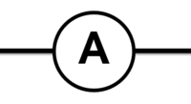
The final circuit component symbols which you need to know about are ammeters and voltmeters.
Ammeters measure the current flowing through a circuit. Ammeters are represented by a circle with an "A" in the middle.
Voltmeters measure the voltage supplied to a circuit. Voltmeters are represented by a circle with a "V" in the middle.
We will learn more about ammeters and voltmeters in the upcoming lessons.

